Slide 1
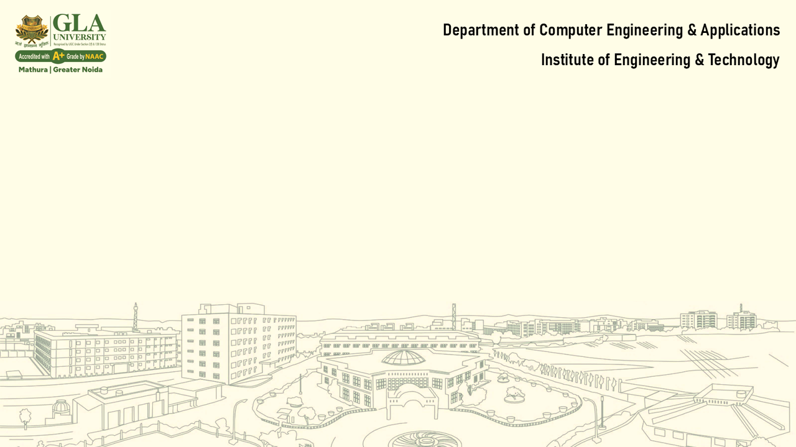
Lecture-1
Database Management system:
DBMS Foundations & Architecture
Topics:
  What is a DBMS? Types: Hierarchical, Network, Relational, NoSQL (briefly).
  DBMS vs RDBMS.
  Three-level architecture: External, Conceptual, Internal.
  Components of DBMS and data independence.
Activity: Identify DBMS use cases in real-world systems (banking, e-commerce).
May 2012
91.2814

Slide 2

What is Database?
        Definition
        A Database Management System (DBMS) is software that enables users to create, manage, and manipulate databases. It provides a way for organizations to store, organize, and retrieve large amounts of data quickly and efficiently. In essence, a DBMS is a software application that acts as an interface between the database and the users or applications that need to access the data

Slide 3
Type : Hierarchical , Network , Relational, NoSQL
In DBMS, hierarchical, network, relational, and NoSQL databases represent different approaches to organizing and managing data. Hierarchical databases use a tree structure with parent-child relationships. Network databases are more flexible, allowing for many-to-many relationships. Relational databases store data in tables with rows and columns, using SQL for querying. NoSQL databases offer flexible, schema-less structures for handling large volumes of unstructured data.
Hierarchical Database:
Structure: Organizes data in a tree-like structure with a single root node and branches.
Relationships: Primarily supports one-to-many relationships (one parent node can have multiple child nodes).
Use Cases: Suitable for scenarios with clear hierarchies, like organizational structures, file systems, or taxonomies.
Flexibility: Less flexible than other models, especially for complex relationships.
Network Database:
Structure: Uses a graph-like structure, allowing data to have multiple connections.
Relationships: Supports one-to-many and many-to-many relationships, offering more flexibility than hierarchical databases.
Use Cases: Well-suited for complex environments with intricate relationships, like social networks or airline reservation systems.
Complexity: Can be more complex to design and manage than hierarchical databases.

Slide 4
Relational Database (RDBMS):
Structure: Organizes data in tables with rows and columns.
Relationships: Uses SQL for querying and managing relationships between tables.
Use Cases: Commonly used in applications like CRM, financial systems, and e-commerce.
Advantages: Offers data integrity through normalization, data consistency, and ACID properties.
NoSQL Database:
Structure:
Offers flexible, schema-less structures, meaning they don't require a predefined schema like RDBMS.
Data Types: Supports various data types, including document-oriented, key-value, wide-column, and graph databases.
Use Cases: Ideal for big data, real-time applications, and scenarios where flexibility and scalability are crucial.
Scalability: Often designed for horizontal scaling, making them well-suited for handling large volumes of data

Slide 5
DBMS Vs RDBMS
A DBMS (Database Management System) is a software application that manages and organizes data within a database, while an RDBMS (Relational Database Management System) is a specific type of DBMS that uses a relational model to structure data. RDBMS stores data in tables with rows and columns, allowing for relationships between tables through keys, while DBMS can store data in various formats like hierarchical, network, or object-oriented.
Here's a more detailed breakdown:
DBMS (Database Management System):
Definition: A software system that helps manage and organize data within a database.
Data Structure: Can store data in different formats, including hierarchical, network, or object-oriented models.
Relationships: May not enforce relationships between tables as tightly as RDBMS.
Example: Windows Registry, Microsoft Access, and XML can be considered examples of DBMS.
Use cases: Smaller organizations with less data or applications that require less complex data organization might use a DBMS.

Slide 6
RDBMS (Relational Database Management System):
Definition: A specific type of DBMS that uses the relational model for data organization.
Data Structure: Stores data in tables with rows and columns, enabling relationships between tables using keys (primary and foreign keys).
Relationships: Enforces relationships between tables through the use of foreign keys, allowing for data consistency and integrity.
Query Language: Typically uses SQL (Structured Query Language) for data manipulation.
Example: MySQL, PostgreSQL, Microsoft SQL Server, and Oracle Database are examples of RDBMS.
Use cases: Larger organizations with complex data, transactional systems, and applications requiring robust data management are well-suited for RDBMS.

Slide 7
Key Differences:
Feature | DBMS | RDBMS
Data Structure | Hierarchical, network, object-oriented | Tabular (rows and columns)
Relationships | May not enforce relationships | Enforces relationships (keys)
Query Language | Varies | SQL (Structured Query Language)
Scalability | Can be limited | Highly scalable
Complexity | Simpler | More complex
Data Consistency | May vary | Enforced through constraints
Use Cases | Smaller organizations, simpler data | Larger organizations, complex data

Slide 8
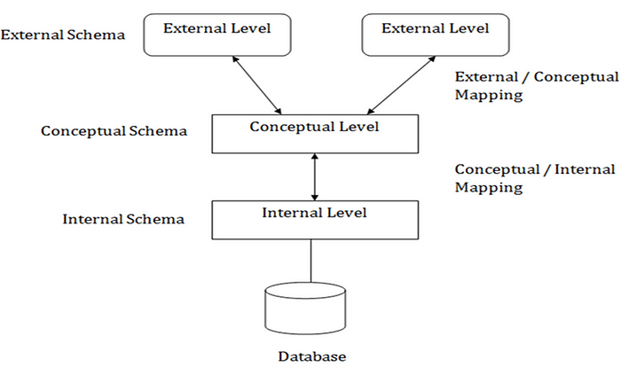
Three Level Architecture
The Three-Schema Architecture is a well-structured framework for database management systems (DBMS) that separates the database into three distinct layers. This separation enhances flexibility, abstraction, and independence, making it easier to manage and modify the database.
The architecture, proposed by the ANSI/SPARC committee, serves as a guide for designing and interacting with databases. Let’s explore its components, advantages, and practical implications.

Slide 9
Overview of the Three-Schema Architecture
The three layers of this architecture are:
  External Schema (View Level)
  Conceptual Schema (Logical Level)
  Internal Schema (Physical Level)
Each layer is independent of the others, ensuring data abstraction and separation of concerns.
1. External Schema (View Level)
What it does: Provides tailored views of the database to different users or user groups.
Purpose: Offers customized access while hiding irrelevant details.
Example: A customer sees their account balance, while a bank manager accesses detailed financial reports.
Characteristics:
Multiple external schemas can exist.
Security and privacy are ensured by restricting access to specific data.

Slide 10
2. Conceptual Schema (Logical Level)
What it does: Represents the logical structure of the entire database.
Purpose: Provides a unified view of the data for all external schemas, independent of how data is physically stored.
Example: Defines entities like Customers and Accounts with attributes and relationships.
Characteristics:
Hides physical storage details.
Maintains data integrity and enforces constraints.
Focuses on logical design and relationships.
3. Internal Schema (Physical Level)
What it does: Deals with the physical storage of data on hardware.
Purpose: Optimizes storage, retrieval, and performance.
Example: Specifies file structures, indexes, and storage strategies.
Characteristics:
Determines how data is physically stored in the database.
Manages performance aspects like data compression and indexing.

Slide 11
Illustration of the Three Layers
Real-World Analogy
Think of the architecture as a library system:
External Schema: A user interacts with a search catalog, seeing only books in their area of interest (e.g., fiction or non-fiction).
Conceptual Schema: The librarian knows the entire catalog, including all books, authors, and classifications.
Internal Schema: The library storage system determines how books are physically arranged (e.g., by ISBN or shelf number).
Advantages of the Three-Schema Architecture
Data Independence: Data independence is a key benefit of this architecture
Logical Independence: Changes to the conceptual schema do not affect external schemas. Changes to the logical structure (e.g., adding a new entity) don’t disrupt external views.
Example: Adding a new column Email in the Customer table won't affect the customer’s view of their account balance.
Physical Independence: Changes to the internal schema do not affect the conceptual schema.
Changes to physical storage (e.g., reorganizing files) don’t impact the logical schema.
Example: Shifting from one storage format to another doesn’t affect queries.
Flexibility: Multiple external schemas allow customized views for different users.
Security: Sensitive data is protected by limiting access at the external level.
Maintainability: Modular design simplifies updates and system upgrades.

Slide 12
Component of DBMS and Data independence
Data Independence Levels:
Physical Data Independence: Enables changes to the physical storage of the data without impacting the logical structure or user views. For example, migrating to a different storage medium like from tape to disk does not necessitate changes to the application.
Logical Data Independence: Allows changes to the logical structure of the database (like adding or deleting columns) without affecting the application programs or user views. For example, renaming a table or adding a new attribute can be done without altering the application.
DBMS Components: A typical DBMS includes:
Hardware: Physical components like servers, storage devices, and networking equipment.
Software: The DBMS software itself, which manages the database, handles queries, and enforces security.
Data: The actual data stored in the database, including tables, indexes, and views.
Procedures: Stored procedures, functions, and triggers that automate database operations.
Database Access Language: Languages like SQL used to interact with the database.
Users: Individuals who interact with the DBMS, including database administrators and application users

Slide 13
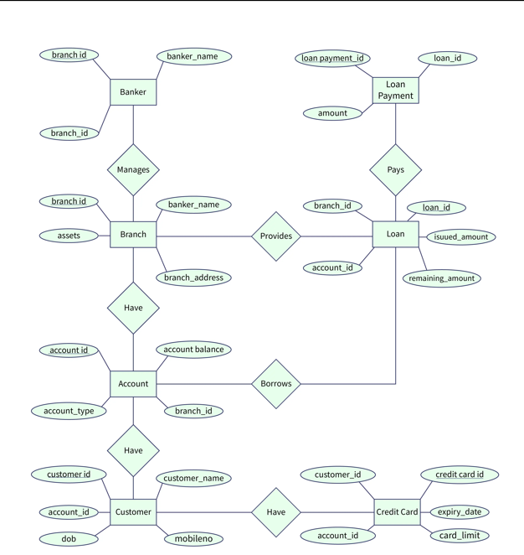
ER Diagram for Bank Database

Slide 14
